Slide 1
PREDICTING STROKE
USING MACHINE LEARNING
Tran Thi Thu Trang - 11208164

Slide 2
TABLE OF CONTENTS
01
04
02
05
03
06
ABSTRACT
INTRODUCTION
CONSTRUCTION FOR MODEL
LITERATURE SURVEY
RESULT
THEORY OF MODEL
CONCLUSION

Slide 3
ABSTRACT
Stroke is the second greatest cause of death worldwide and the third leading cause of disability
Predicting a stroke is critical for avoiding serious health consequences or death.
The objective is to detect stroke risk in patients by using machine learning classification algorithms on features derived from available dataset.
Models used for stroke prediction included Logistic Regression, Random Forest, Decision Tree, and K-Nearest Neighbor (KNN)
Random Forest technique has the best classification accuracy (CA) of 94.9%

Slide 4

01
INTRODUCTION

Slide 5

WHAT IS A STROKE?
Stroke is a serious disease that takes a person's life:
A stroke happens when a blockage or hemorrhage in the blood arteries disrupts or lowers the flow of blood to the brain. When this occurs, the brain does not receive enough oxygen or nutrients, causing brain cells to die.
Stroke is a cerebrovascular disorder

Slide 6

Indicators of a stroke:
Dizziness, trouble speaking or comprehending
Other signs include fainting or seizures and severe, unexplained headaches.
Blurred or lost vision in one or both eyes
Numbness in the arms, legs, or face, typically on one side of the body
Other unusual stroke symptoms may involve sudden nausea, temporary loss of consciousness, fainting, confusion or coma.
Issues with coordination or balance, walking, or mobility

Slide 7
Type Of Stroke:
Transient Ischemic Attack (TIA)
Ischemic Stroke
Hemorrhagic Stroke
TIA is a condition in which blood supply to the brain is momentarily disrupted.
Patients often recover from this form of stroke in minutes.
This is the most prevalent form of stroke. It happens when a major blood artery in the brain becomes clogged, which can be caused by a blood clot.
It may also get clogged due to an accumulation of fat and cholesterol.
Occurs when a brain artery ruptures and spills blood into nearby tissues. Damage to brain cells and tissue occurs when the blood pressure of the arteries is greater than that of the skull.

Slide 8

02
LITERATURE SURVEY

Slide 9
Leila Amini et al. (2013)
Chun-An Cheng et al. (2014)
Teerapat Kansadub et al. (2015)
Adam et al. (2016)
Priya Govindarajan et al. (2020)
Notes:
Leila Amini et al. (2013)A study to predict the incidence of stroke.Use dataset containing 50 risk factors for stroke of 807 healthy and sick subjects. They used data mining techniques: KNN (CA 94.18%) , C4.5 decision trees using WEKA (CA 95.42%).
Chun-An Cheng et al. (2014) Predict the outcome of ischemic stroke patients after intravenous thrombolysis. They collected data from 82 patients and used STATISTICA 10 to select the best artificial neural network. With ANN model 1 (79.27%), ANN model 2 ( 95.12%).
Teerapat Kansadub et al. (2015)Compared Naive Bayes, decision trees, and neural networks for stroke risk prediction. Decision trees were most accurate, while Naive Bayes performed best in the area under the ROC curve (AUC) evaluation.
Adam et al. (2016) Determine the classification of ischemic stroke based on a dataset of 400 cases. They compared KNN and decision tree methods, finding that the decision tree method was preferred by medical experts for stroke classification.
Priya Govindarajan et al. (2020) Utilized text mining and machine learning to classify stroke in 507 individuals. They applied various machine learning algorithms including ANN, SVM, boosting and bagging, random forest. ANN trained with stochastic gradient descent (SGD) algorithm showed the highest CA 95%, outperforming other algorithms.

Slide 10
03
THEORY OF MODEL

Slide 11
3.1.Logistic Regression
Logistic regression is a supervised machine learning method utilized for binary classification tasks.
It estimates the likelihood of a particular outcome or observation.
The model generates a binary outcome with two potential values, such as yes/no, 0/1, or true/false.

Slide 12
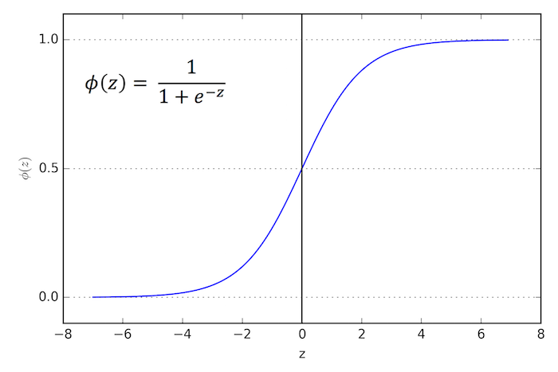
The logistic function also known as sigmoid function exhibits a characteristic S-shaped curve, rising rapidly and plateauing at the carrying capacity of the environment.
The sigmoid function is capable of transforming any real-valued number into a value between 0 and 1, but it never precisely reaches these limits.
Figure 1: Sigmoid function

Slide 13
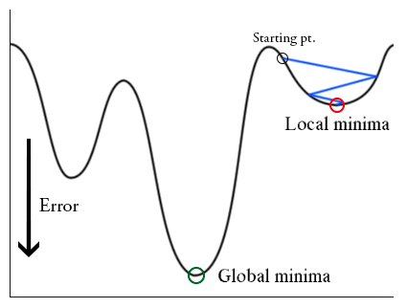
In logistic regression, the relationship between the predicted values (ŷ) and the input variables (z) is nonlinear, as expressed by the sigmoid function. If it is employed within the MSE, it results in a non-convex graph with numerous local minimum.
To address this issue, logistic regression employs a different cost function known as log loss, which is also derived from the Maximum Likelihood Estimation (MLE)

Slide 14

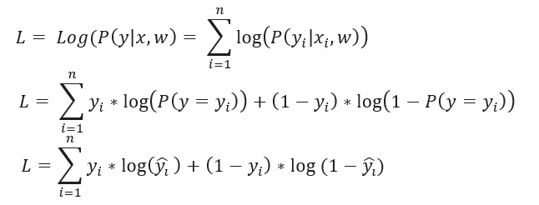

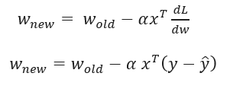
Direct optimization of the likelihood function, the logarithm is applied to convert the product to a sum, simplifying the optimization process.
=> Maximizes the log-likelihood function:
In order to determine the appropriate value for w, the Gradient Descent optimization method is commonly employed.

Slide 15
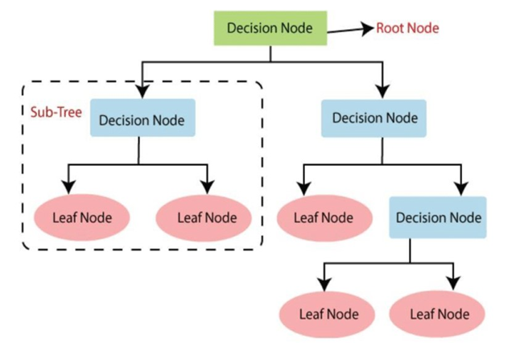
3.2.Decision tree
A decision tree is a non-parametric supervised learning algorithm for classification and regression tasks.
It has a hierarchical tree structure consisting of a root node, branches, internal nodes, and leaf nodes , forming a hierarchical, tree-like structure.
This algorithmic model utilizes conditional control statements and is non-parametric, supervised learning.
Figure 2. Decision Tree algorithm

Slide 16
The process of creating a decision tree involves the following steps:
Step1: Begin the tree with the root node, denoted as S, which encompasses the entire dataset.
Step2: Determine the best attribute in the dataset using an Attribute Selection Measure (ASM).
Step3: Partition the dataset S into subsets based on the possible values of the best attribute.
Step4: Create a decision tree node containing the best attribute.
Step5: Recursively construct new decision trees using the subsets of the dataset generated in step 3. Continue this process until a stage is reached where further classification is not possible, and designate the final node as a leaf node.

Slide 17

Entropy
Entropy is a term in Thermodynamics, a measure of change, chaos or randomness.
In 1948, Shannon expanded the concept of Entropy to the field of research and statistics with the following formula:

Slide 18
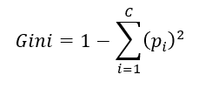
Gini index
The Gini index is another measure used to evaluate the degree of inequality in the distribution of classes, besides the entropy function.
It quantifies the impurity of a node and is calculated as follows.
The Gini index subtracts the sum of the squared probabilities of each class from 1. This index ranges from 0 (perfectly pure) to 1 (maximum impurity), where a lower Gini index indicates a more homogenous node.

Slide 19
Disadvantages
Advantages
Model provides easy-to-understand rules for the reader.
There is no need to normalize or generate fake variables for input data that contains missing values.
Can deal with numerical and categorical data.
Capable of handling large amounts of data.
The structure of the decision tree model can vary substantially even if the data set is just slightly altered.
Overfitting issues are common with decision trees.
If a deep enough tree is constructed, it is possible for each leaf node to contain a small number of samples from a specific class, resulting in excessive model complexity.

Slide 20
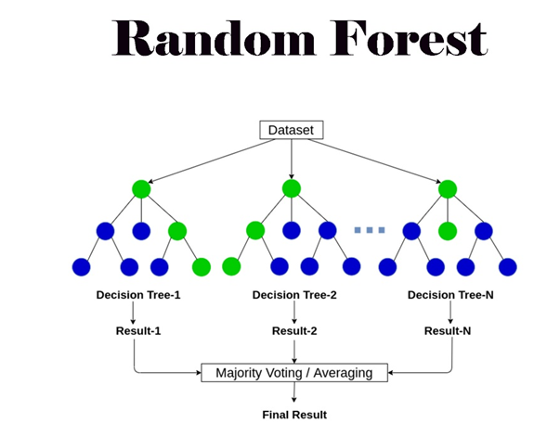
3.3. Random Forest
Random forest, a popular machine learning algorithm, merges the outputs of numerous decision trees to produce a single outcome.
Its popularity stems from its user-friendliness and versatility, making it suitable for both classification and regression tasks.
Its strength lies in its capability to manage complex datasets and alleviate overfitting, rendering it invaluable for a range of predictive tasks in machine learning.
Figure.4. Example of a Random.Forest model’s workflow

Slide 21
The Random Forest algorithm operates through several key steps:
Ensemble of Decision Trees
Random Feature Selection
Bootstrap Aggregating or Bagging
Decision Making and Voting

Slide 22
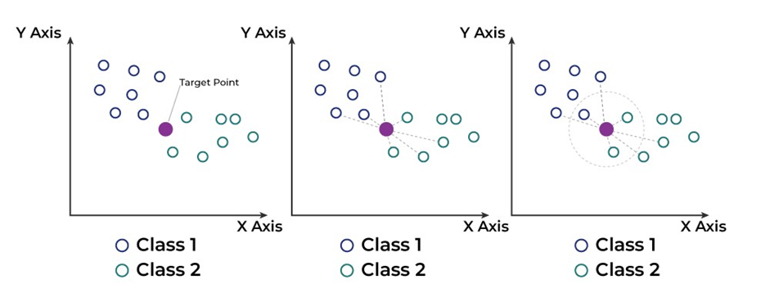
3.4. K-Nearest Neighbors Classifier (KNN)
The K-Nearest Neighbors (KNN) algorithm is a fundamental classification algorithm in machine learning.
It falls under the supervised learning domain and finds extensive application in pattern recognition, data mining, and intrusion detection.
Figure 5. Example of a K-NN algorithms

Slide 23
The working of the K-Nearest Neighbors (KNN) algorithm as follows:
Step 1: Selecting the optimal value of K
K represents the number of nearest neighbors to be considered when making a prediction.
Step 2: Calculating Euclidean distance
To measure the similarity between the target data point and the training data points, distances are calculated.
Step 3: Finding the K nearest neighbors
the K nearest neighbors to the target data point are identified.
Step 4: Making predictions
Step 5: Output
The predicted class or value is returned as the output of the algorithm.

Slide 24
Disadvantages
Advantages
KNN performs poorly when the data set is huge because computing the distance between data points takes a lengthy time.
KNN is not an appropriate method for handling huge datasets.
KNN is subject to noise in the data and data points in various classes that are near together.
If one class has more samples than another, KNN can quickly become biased and generate incorrect results.
KNN is a basic and understandable algorithm.
KNN is capable of handling unstructured data and makes no assumptions about data structure.
Also works effectively on tiny datasets with a limited number of samples.
Easily fine-tune parameters with K being an important parameter in the KNN algorithm.

Slide 25

3.5. Metrics
3.5.1. Precision, Recall and F1 score
Accuracy
is a metric that measures how often a machine learning model correctly predicts the outcome. Accuracy was calculated by dividing the number of correct predictions by the total number of predictions.

Slide 26


Precision
is a metric that measures how often a machine learning model correctly predicts the positive class.
is calculated as the ratio between the number of Positive samples correctly classified as Positive to the total number of Positive samples.The recall measures the model's ability to detect Positive samples. The higher the recall, the more positive samples detected.
Recall

Slide 27
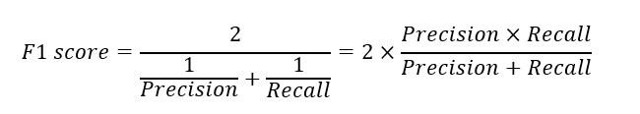
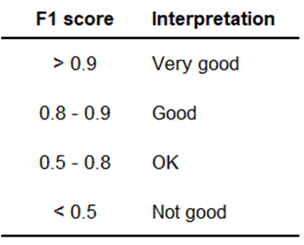
F1 score
or F-measure is described as the harmonic mean of the precision and recall of a classification model. The two metrics contribute equally to the score, ensuring that the F1 metric correctly indicates the reliability of a model.
The F1 score, ranging from 0 to 1, represents the model's performance, with 0 indicating the lowest possible result and 1 representing a perfect outcome, indicating that every label was correctly predicted by the model.

Slide 28
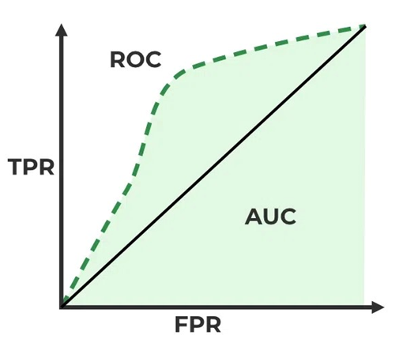
3.5.2. ROC and AUC
ROC stands for Receiver Operating Characteristics, and the ROC curve is the graphical representation of the effectiveness of the binary classification model.
AUC stands for Area Under the Curve, and it refers to the area under the Receiver Operating Characteristic (ROC) curve.
AUC is a metric used to evaluate the overall performance of a binary classification model.
A higher AUC value indicates better model performance, with a value of 1 indicating perfect classification.
Figure 6. ROC-AUC Classification Evaluation Metric

Slide 29
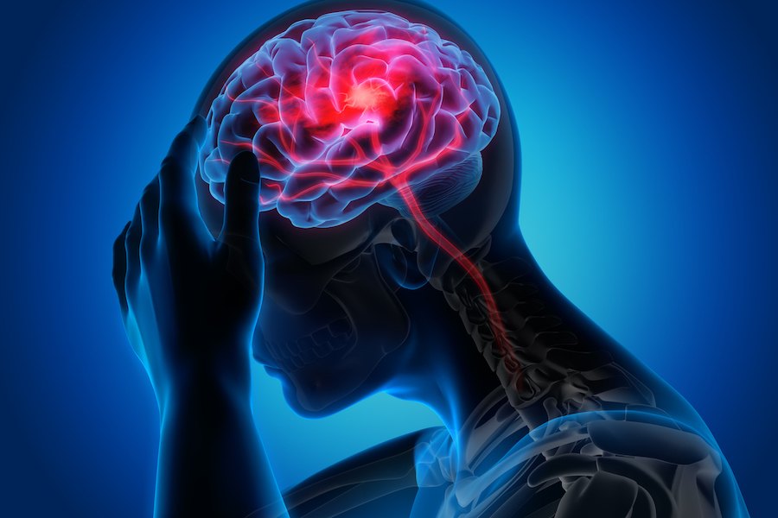
04
CONSTRUCTION FOR MODEL

Slide 30
4.1. Exploratory Data Analysis – EDA

Slide 31
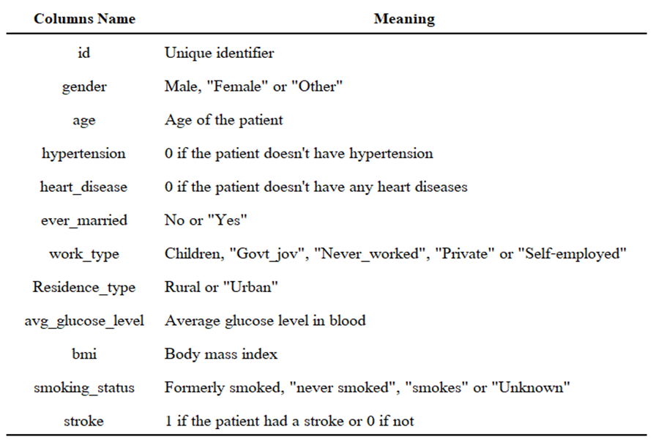
4.1.1. Data Overview
The dataset used in this study was sourced from Kaggle, a publicly available platform, focusing on stroke prediction.
It contains data relevant to strokes, considering factors such as gender, age, various medical conditions, and smoking status to determine a patient's risk of stroke.
Table 1. A summary of the dataset's characteristics.

Slide 32
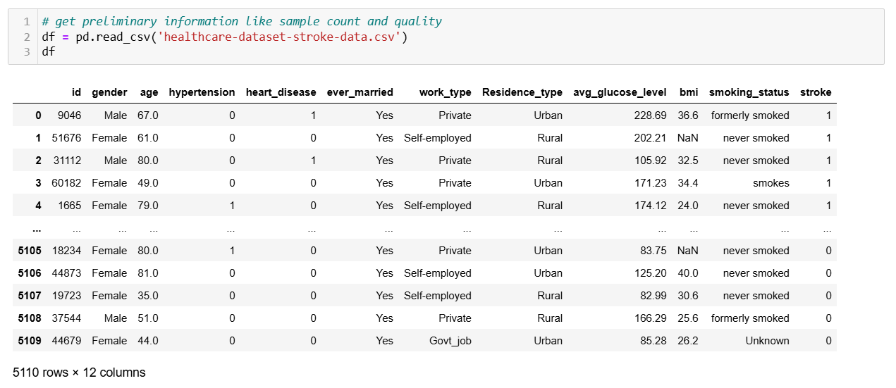
Below is a representation of the appearance of the sample data:

Slide 33
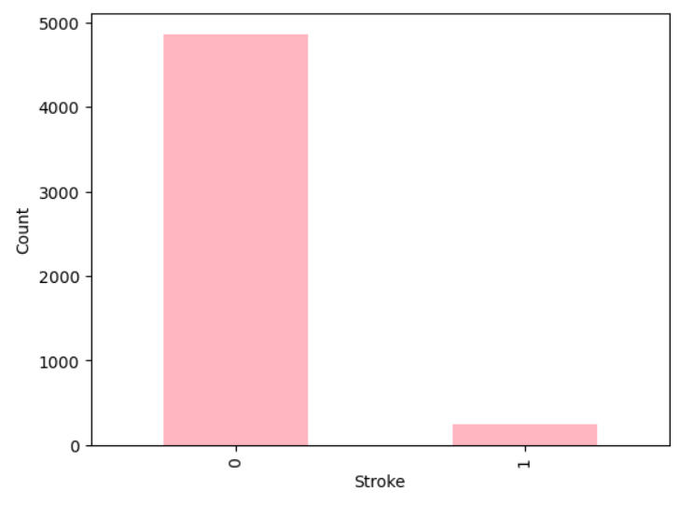
4.1.2. Exploratory data analysis
Stroke – Target feature
Figure 7. Stroke Status

Slide 34
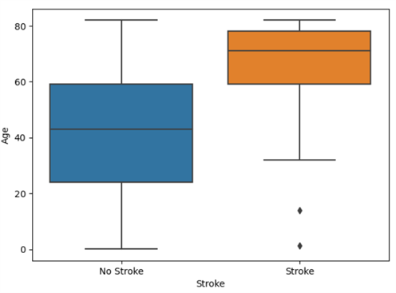
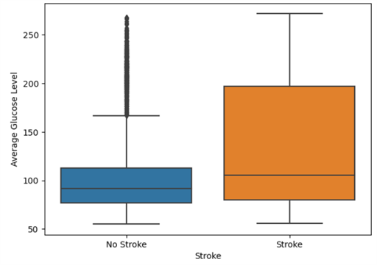
Figure 8. Boxplot of age by Stroke Status
Figure 9. Boxplot of average_glucose_level by Stroke Status

Slide 35
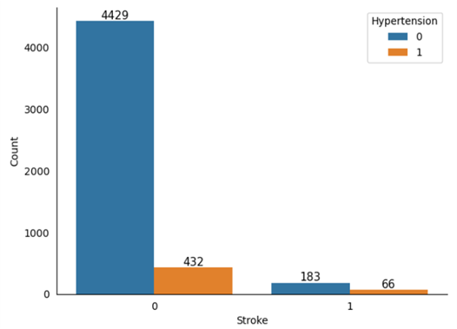
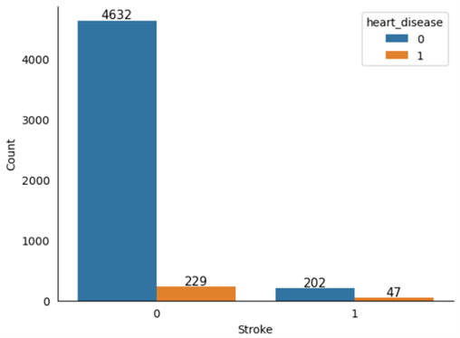
a)
b)
Figure 10. Bar plots depict certain categorical attributes as follows.(a)hypertension.and.(b)heart_disease

Slide 36
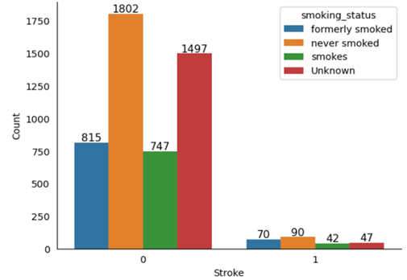
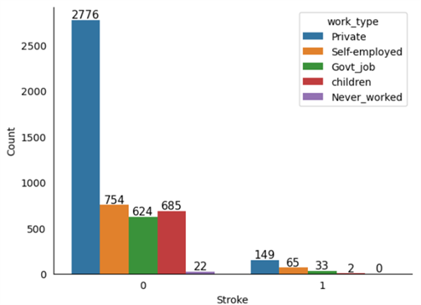
c)
d)
Figure 10. Bar plots depict certain categorical attributes as follows.(c)smoking_status and.(d)work_type

Slide 37
4.2. Data Preprocessing

Slide 38
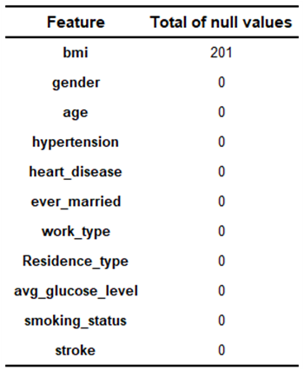
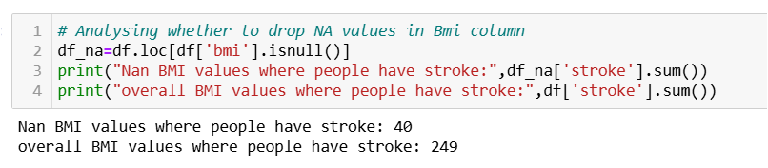
4.2.1. Fill missing values
In table 3, of the 201 NULL values in the bmi property, 40 Nan values out of 249 BMI values had a stroke.
=> As a result, we are unable to discard the NULL value. We cannot calculate the mean because the outliers have an effect on the mean. Hence we impute it with median values.
Table 3. Null values of each feature

Slide 39
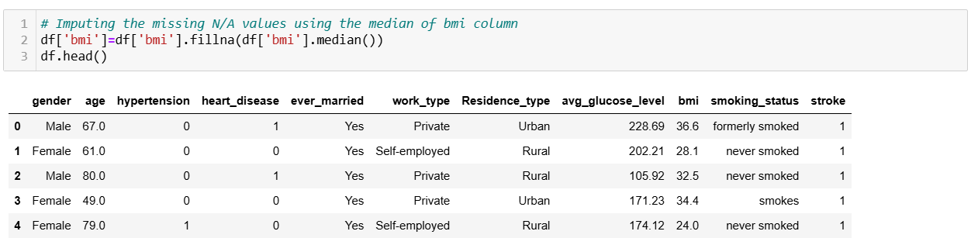

Slide 40
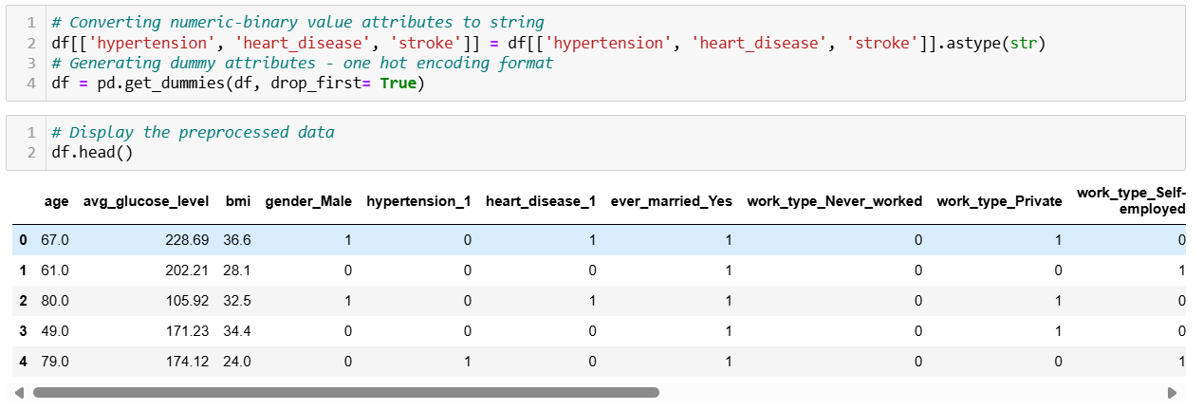
4.2.2. Categorical features
I chose to use dummy encoding for the remaining category variables.

Slide 41
4.2.3. Data Scaling
The data in the article are scaled according to the Standardization (Z-score normalization)method with a mean of 0 and a variance of 1.
This standardization supports algorithms such as logistic regression, as they are often assume that the input data follows a Gaussian distribution.

Slide 42
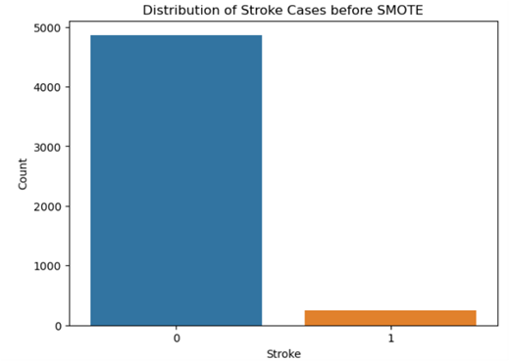
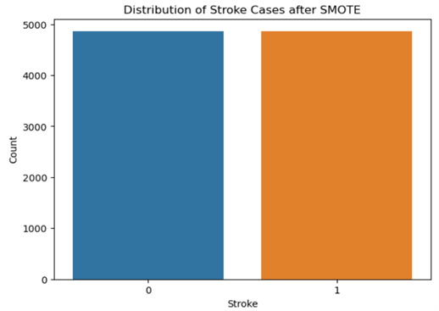
4.2.4. Balance Data using SMOTE
Figure 11.Unbalanced training dataset
Figure 12. Balanced training dataset using Borderline-SMOTE

Slide 43
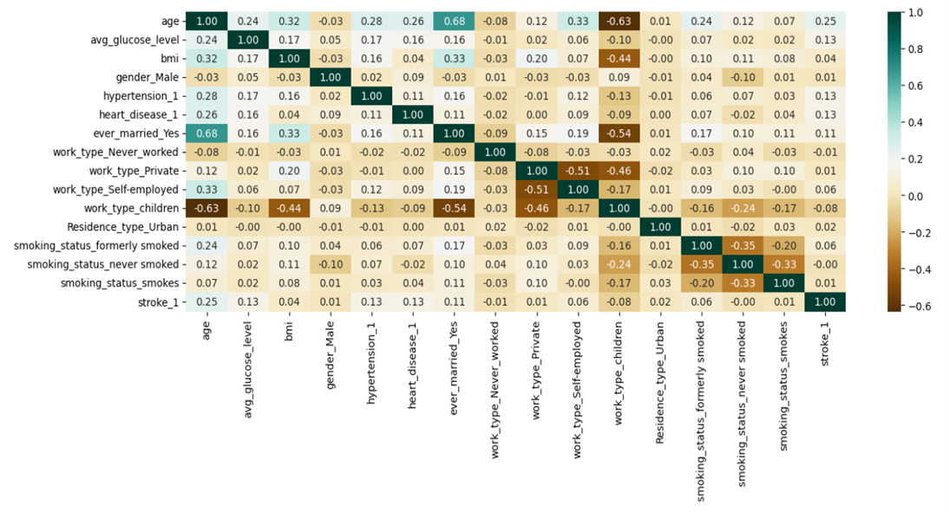
4.2.5. Features Selection
Pearson's Correlation
A heat map provides you with the correlation between each feature on the other values, which is equivalent to a multicollinearity correlation matrix.

Slide 44
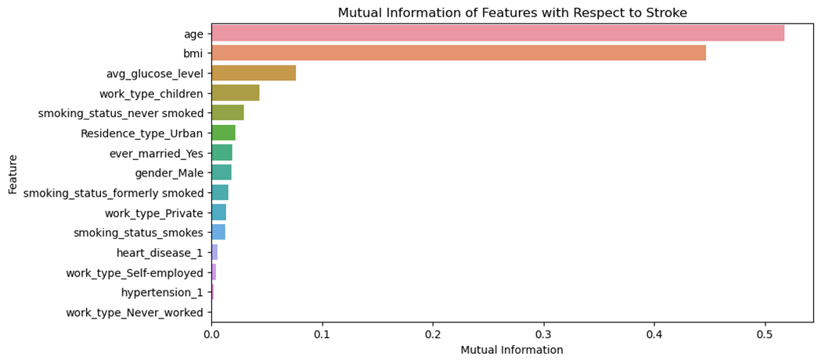
Mutual Information
MI can be used to measure the importance of features to the target variable during the feature selection process. The attributes were ranked based on how much each attribute contributes to the target variable.

Slide 45
05
RESULT

Slide 46
5.1. Model Evaluation
Model | Accuracy | Precision | Recall | F1-Score
Logistic Regression | 79.38% | 0.785 | 0.808 | 0.796
Decision Tree | 90.4% | 0.887 | 0.826 | 0.906
Random Forest | 94.7% | 0.93 | 0.966 | 0.948
KNN | 92.4% | 0.855 | 0.984 | 0.915
Table 4 . Performance Metrics using 80-20 Ratio

Slide 47
Model | Accuracy | Precision | Recall | F1-Score
Logistic Regression | 86.32% | 0.856 | 0.879592 | 0.864
Decision Tree | 92.2% | 0.909 | 0.938 | 0.923
Random Forest | 94.9% | 0.94 | 0.959 | 0.949
KNN | 90.85% | 0.855 | 0.984 | 0.915
Table 5. Performance Metrics using 5-fold cross validation

Slide 48
5.2. Hyperparameter tuning
Algorithm | Hyperparameters
Logistic Regression | {'C': 0.2, 'penalty': 'l1', 'solver': 'liblinear'}
Decision Tree | {'criterion': 'entropy', 'max_depth': 20, 'min_samples_leaf': 1}
Random Forest | {'bootstrap': False, 'max_depth': None, 'min_samples_leaf': 1, 'min_samples_split': 2, 'n_estimators': 200}
KNN | {'metric': 'minkowski', 'n_neighbors': 3, 'weights': 'distance'}

Slide 49
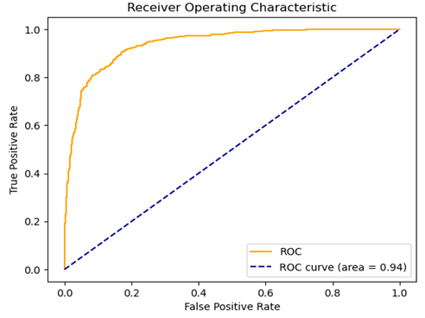
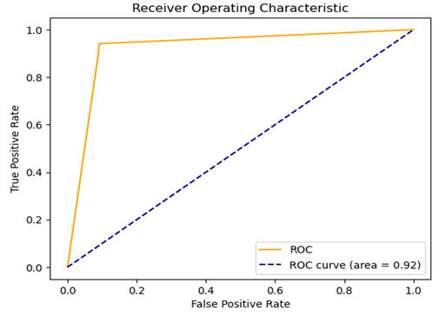
5.3. ROC_AUC
Figure 15. Logistic Regression algorithm ROC
Figure 16. Decision Tree algorithm ROC

Slide 50
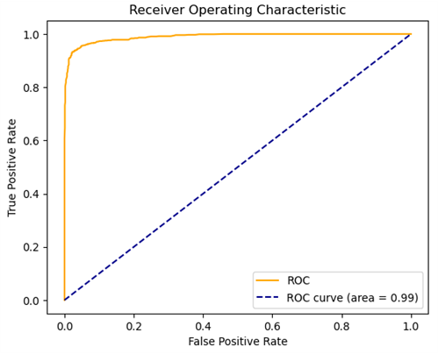
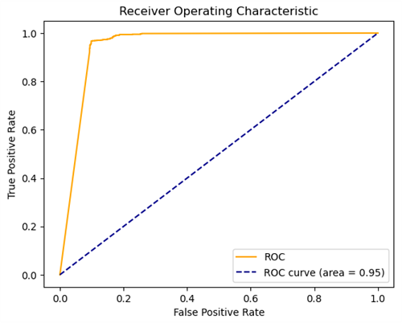
Figure 17. Random Forest Classifiers ROC
Figure 18. K-NN algorithm ROC

Slide 51

06
CONCLUSION

Slide 52
Thank You !

